Slide 1
Analysis of Hydrophone Data for the North Carolina Renewable Ocean Energy Project
Steve Lockhart
7/5/2017
Notes:
I’ve been doing some work recently involving acoustical signal processing. You’ll see examples of detection, classification, statistical analysis, filtering and general signal processing in the time domain and in the frequency domain. Hopefully these skills will translate well to the type of work that you are doing here.

Slide 2
Outline
Introduction
Background Noise
Signals of Interest
Whistles
Echolocation Clicks
Low-frequency signals
Data Processing Overview
Detection
Classification
Approach
Example from previous project
Correlating Detections to Oceanographic Features
Using a statistical approach (K-S test)
Using insight into the physical processes

Slide 3
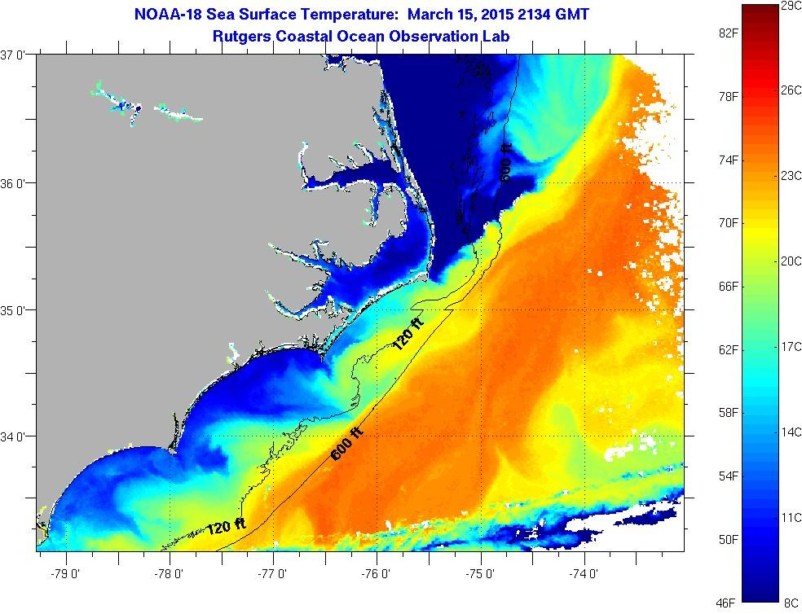
Introduction
Satellite image of sea surface temperature (SST) near Cape Hatteras on March 15, 2015, from Rutgers Coastal Ocean Observation Lab (COOL). I’ve added a star to show the location of our mooring, at a depth of 230m.
Notes:
This slide puts our mooring on the map. It is deployed at a depth of 230m off Cape Hatteras, NC. The mooring has been deployed to gather data in support of a proposed renewable energy project, sponsored by the UNC Coastal Studies Institute’s North Carolina Renewable Ocean Energy (NCROE) Project. At this location, sometimes the Gulf Stream is over the mooring; at other times, the Gulf Stream meanders farther offshore.

Slide 4
Introduction
Instruments on the mooring:
AURAL-M2 hydrophone
Sampling under water sound at max rate of 32768 samples/second
Sampling for 5 minutes out of every half-hour
CTD
Temperature (at the bottom)
Salinity (at the bottom)
Pressure (at the bottom)
Acoustic Doppler Current Profiler (ADCP)
Velocity field (above the mooring)
Acoustic backscatter field (above the mooring)
Notes:
On the mooring, we have deployed not only a hydrophone but also a CTD and ADCP. As we’ll see, these instruments will allow us to correlate the marine mammal vocalizations to oceanographic features.

Slide 5
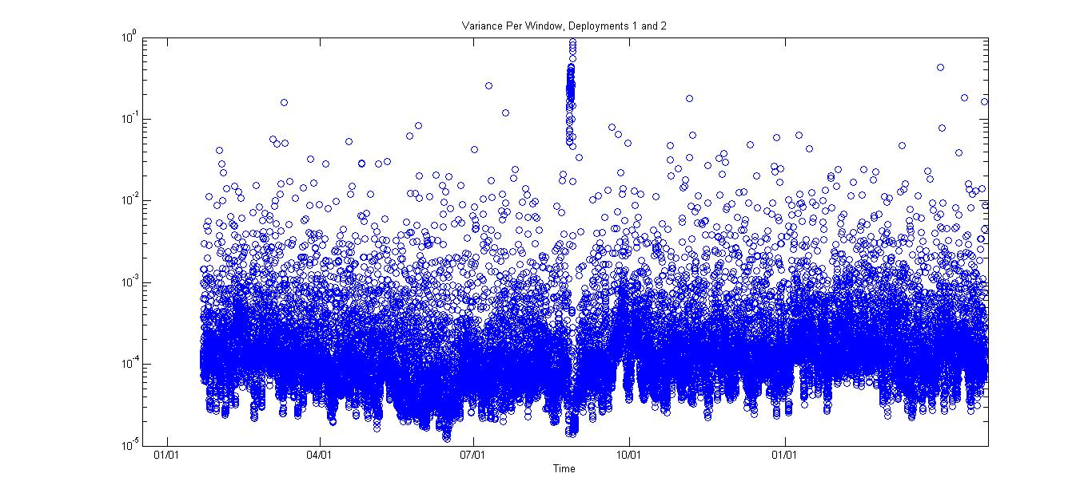
Background Noise: Variance Per Recording Interval
For deployments 1 and 2, the variance per recording interval. This is one way to look at how “loud” the underwater sound was at the hydrophone.

Slide 6
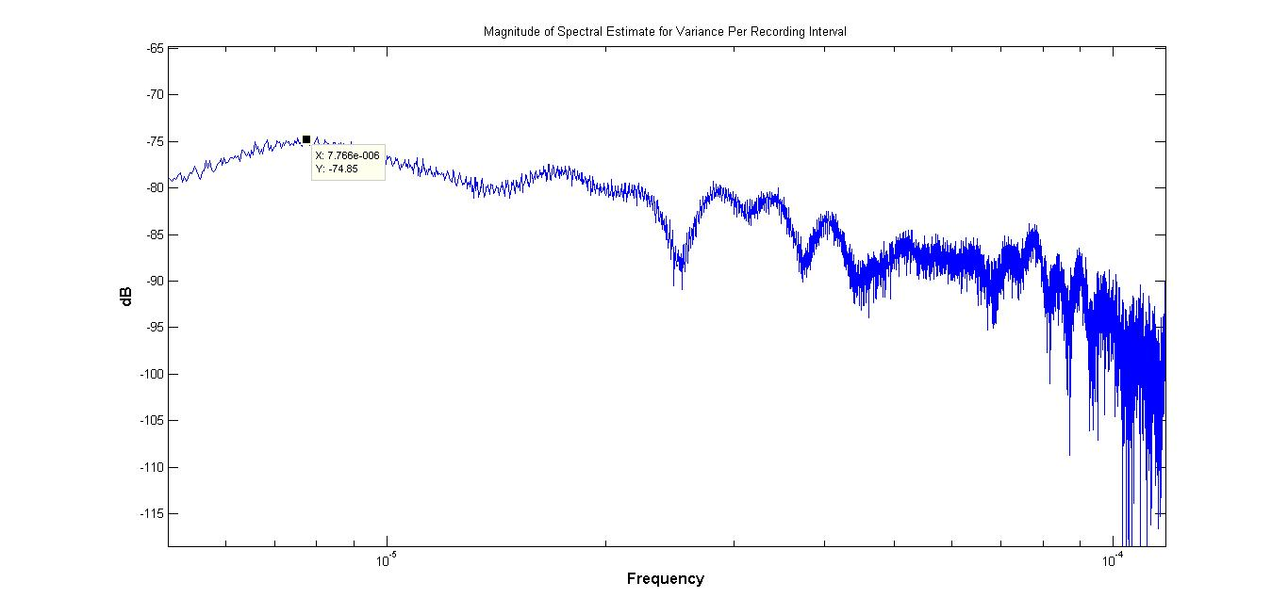
Background Noise: Variance Per Recording Interval
For deployment 1, this is the spectrum of the time series from the previous slide i.e. the “loudness” per recording interval. It shows peaks at 1/week and 2/week.

Slide 7
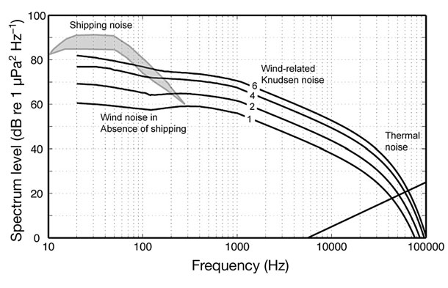
Background Noise: Expected Spectrum
From Hildebrand (2009), his Figure 1: “Generalized ocean ambient noise spectral levels for a deep-water
site with the receiver located at 1000 m depth.”
Notes:
Here is a graphic showing the different noise sources in the ocean—both anthropogenic and natural—and how they contribute to the spectrum.

Slide 8
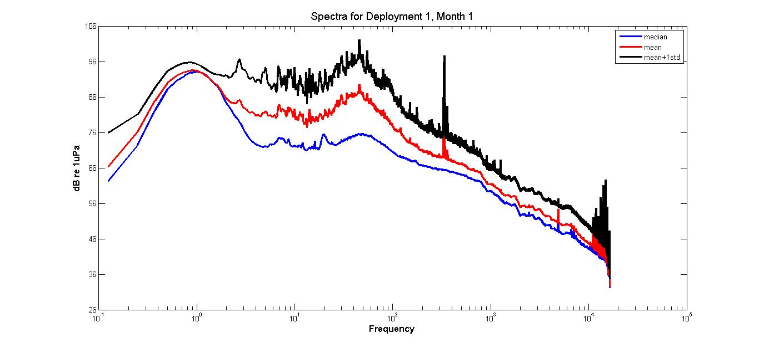
Background Noise: Actual Spectrum
From NCROE hydrophone data deployment1 (January-August 2015). The AURAL-M2 hydrophone has a usable frequency range from 10 Hz to 16 kHz.
Notes:
Here is a plot from the data acquired from the first 30 days of the first deployment of the hydrophone (i.e. from January 22 to February 22, 2015). I have plotted the media, mean, and mean+1 standard deviation. We can see that the distribution is not normal. Note that some instrument noise (e.g. pumped CTD) has not been removed yet, so they contribute to some of the highest frequency peaks. Also, note that the manufacturer says that the “usable” frequency starts at 5-10 Hz. (I need to get the frequency response curve for our instrument.)

Slide 9
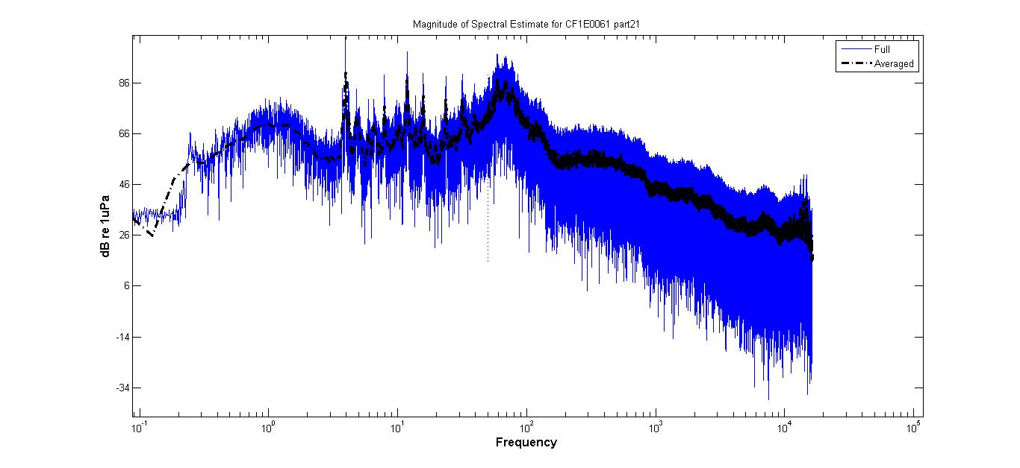
Background Noise: Actual Spectrum
From NCROE hydrophone data when there was clearly ship noise.
Notes:
Here is the same spectral plot but just for one 5-minute recording interval. I chose one that had loud ship noise in it.

Slide 10
Data Processing Overview
{Original (Large) Wav Files}
Chop
{Chopped Wav Files}
(one per 5-minute interval)
QC
Whistle
Detect/Classify
Click
Detect/Classify
LF
Detect/Classify
Other
Events
Analyze Events
e.g. Histograms
(Temporal Analysis and
Correlation to Oceanographic Variables)
Notes:
This is an overview of my data processing (in matlab). I’ve highlighted the pieces that I have implemented so far.

Slide 11
Detect Whistles
For each of the 20,000+ wav files (5-minute recording interval):
Use a matched filter to locate the instrument noise; replace instrument noise with white Gaussian noise (of the same amplitude as the median background noise for that wav file).
High-pass filter with cut-off frequency of 1 kHz.
Call Silbido to detect whistles ( beta2 version at http://roch.sdsu.edu/index.php/software/ ).
Process the returned detection event.
Post-processing to remove some man-made sounds like sonar.
Add up the duration of whistling (in seconds) per 5-minite recording interval. This is the vocalization metric for whistles.
Notes:
Here are the steps I follow in my matlab code to detect whistles, leveraging Silbido.

Slide 12
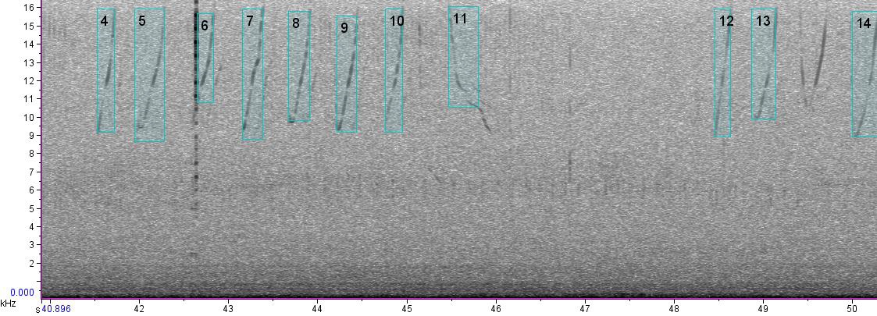
Detect Whistles
Sample spectrogram (using Raven), with time (in seconds) on the x-axis and frequency (in kHz) on the y-axis. The whistles detected by Silbido are highlighted.
Notes:
Here are some sample whistles that I detected. After calling Silbido, I process the output. One format of the output is a “selection” table that I can import into Raven—just so I can manually inspect a few of the automated detections. (Raven is a nice tool that shows the spectrogram and plays the sound at whatever speed you want.)

Slide 13
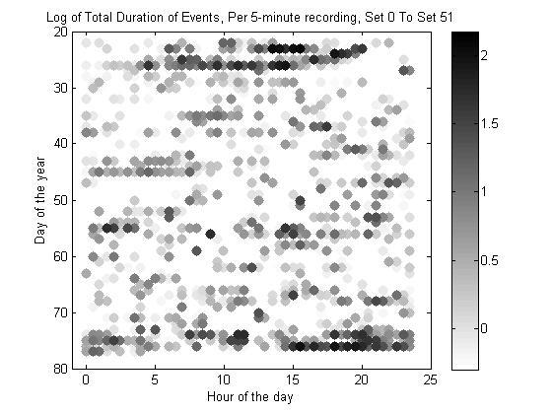
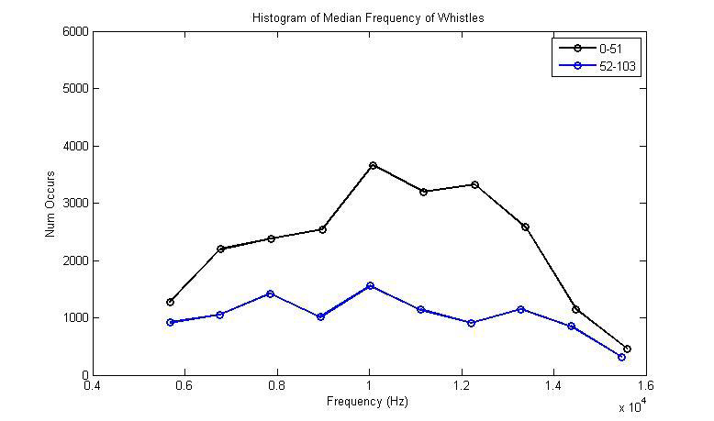
Detect Whistles
Once we have the detected whistles, we can do spectral and temporal analysis of them. Here are just a couple examples.
Notes:
I also store information about each detected whistle in a mat file for subsequent analysis. Here are some examples of my temporal and spectral analysis of the results.

Slide 14
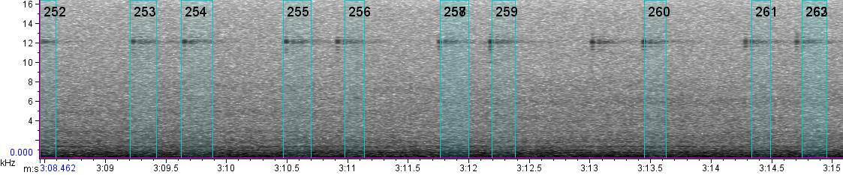
Detect Whistles
In general, the beta2 version of Silbido has a very low false alarm rate (less than 10%). Here, I’m showing that 12kHz sonar pings were erroneously detected by Silbido as whistles, so I did some post-processing to remove them, further reducing false alarms.
Notes:
One thing I found from my spectral/temporal analysis is that Silbido was detecting some man-made sounds as whistles, like these 12kHz sonar pings. So, I did some post-processing of the detection events and removed them.

Slide 15
Detect Click Trains
For each of the 20,000+ wav files (5-minute recording interval):
Use a matched filter to locate the instrument noise; replace the instrument noise with white Gaussian noise (of the same amplitude as the median background noise for that wav file).
High-pass filter with cut-off frequency of 1 kHz.
My custom matlab code implements a Teager–Kaiser energy operator to detect clicks (Kandia and Stylianou, 2006)
Φ(x(n))= X²(n) – X(n+1)X(n-1)
Group clicks into click trains.
Notes:
Here are the steps I follow in my matlab code to detect clicks and group them into click trains.

Slide 16
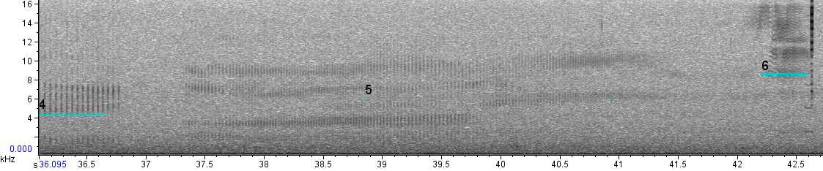

Detect Click Trains
Sample spectrogram (using Raven), with time (in seconds) on the x-axis and frequency (in kHz) on the y-axis. The detected click trains are highlighted.
Notes:
Here is a spectrogram of some detected click trains, with a “buzz” at the end, where the marine mammal is zooming in on the target.

Slide 17
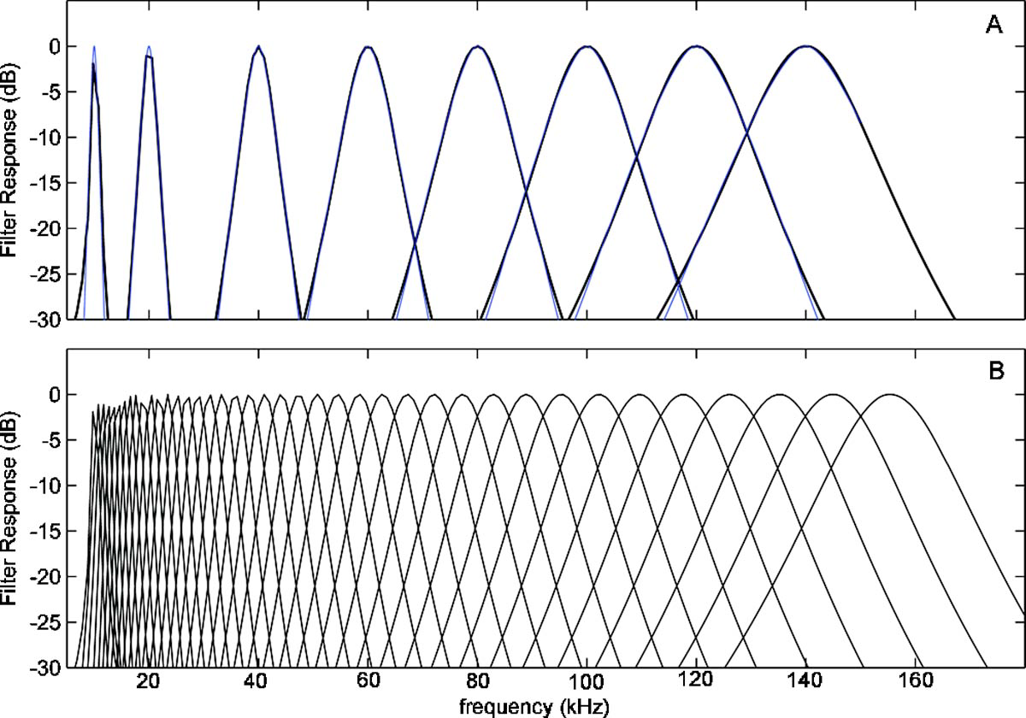
Detect low-frequency vocalizations (“Sub-band synchronicity”)
Process the sound with a gammatone filter bank
Look for covariance between certain bands (after demodulating to a common “base” band).
If the covariance between certain bands is above a threshold, we have detected our signal.
From Branstetter et al. their Figure 2
Notes:
Here’s an approach I tried for detecting low-frequency signals that usually have harmonic content. The technique, called “sub-band synchronicity”, is biologically-inspired. Like the human auditory system, it breaks the signal down into sub-bands and looks for correlation across the sub-bands. I searched on patents and found that some speech detectors use this algorithm (e.g. voice-activated devices).

Slide 18
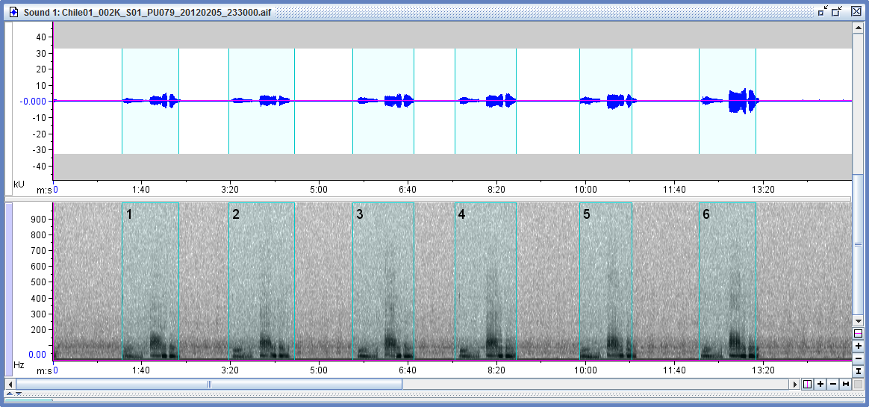
Detect low-frequency vocalizations (“Sub-band synchronicity”)
After finding some cross-correlation between the sub-bands, here are some signals I detected using this approach on another data set (Blue whales off the coast of Chile.)

Slide 19
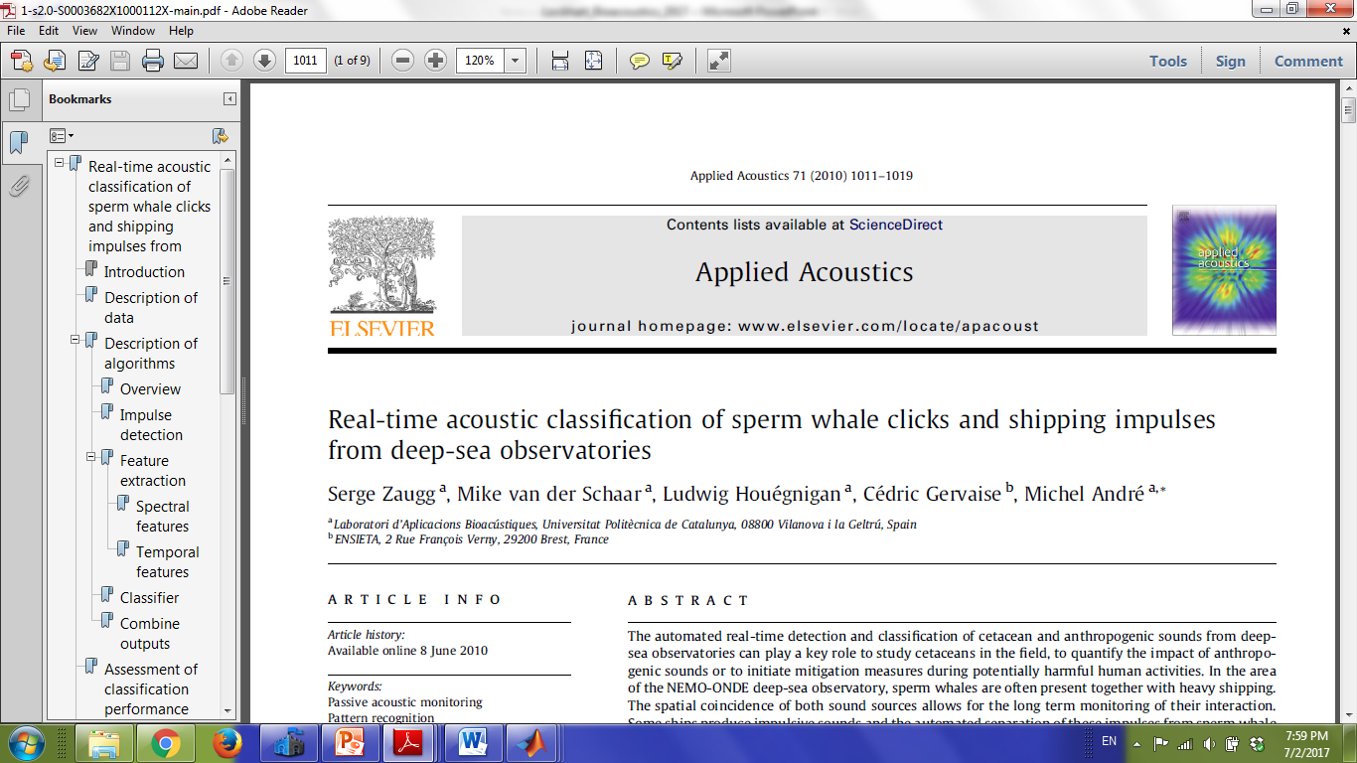
Classification
I currently have too many false alarms—confusing clicks with ship noise. So, I am working on classifying click trains based upon the set of 9 features documented in this article by Zaugg et al.
Notes:
My simple approach for detecting clicks has too many false alarms due to ship noise. So, I currently have a project to come up with some better features—not only to classify click trains by species but also to separate them from ship noise. This paper documents 9 features and uses a neural network-based classifier.

Slide 20
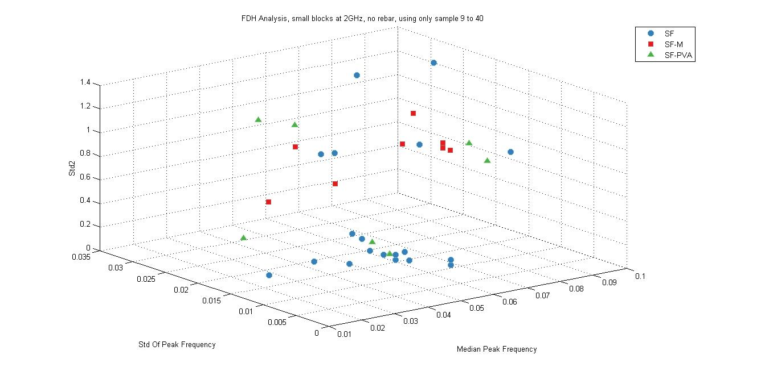
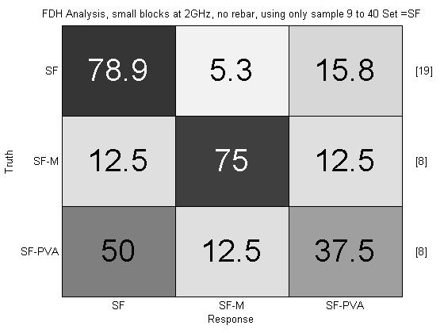
Classification Example (Another Project)
ds = prtDataSetClass(feature_Array, label_Array);
classifier = prtClassMatlabTreeBagger; % Instantiate a classifier
trainedClassifier = classifier.train(ds); % Train classifier
Notes:
The click train classifier is a work in progress, so here I just wanted to share some output of a previous classification effort, to show you that I know what I’m talking about when it comes to classification problems. In this project, I used a custom Pattern Recognition Toolbox for matlab to classify different types of concrete blocks—those with metal fiber, plastic fiber, or no fiber. (It’s always good to have a “concrete” example of what you’re talking about.)

Slide 21
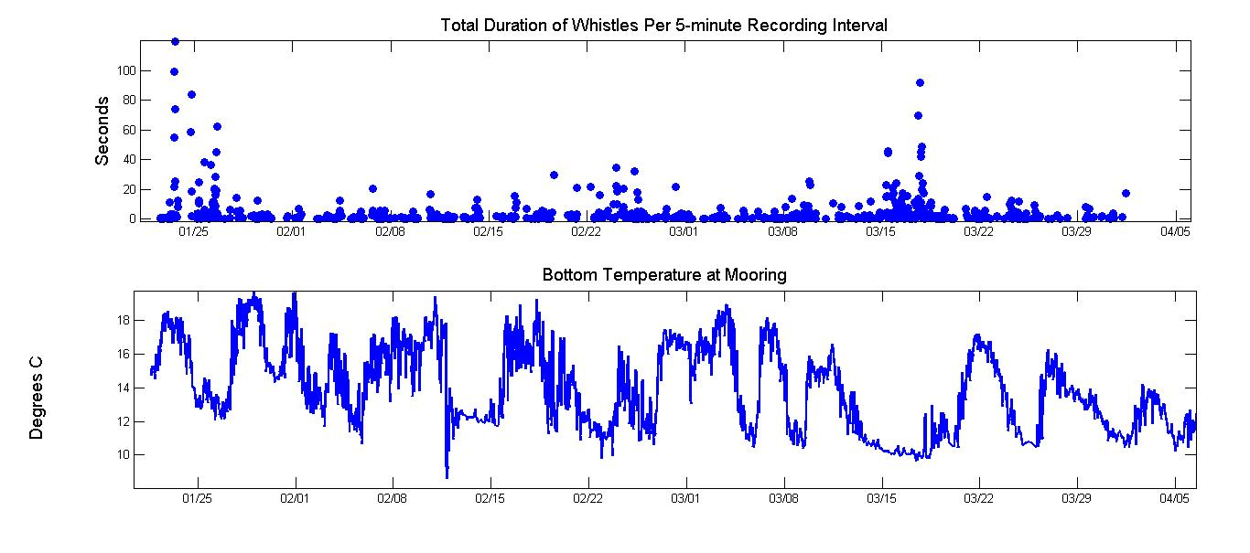
Correlating Detections to Oceanographic Features
Time series of the vocalization metric and oceanographic variables, zooming in on the period from January 22, 2015 to April 1, 2015. The top panel a time series of the vocalization metric. The third panel shows a time series of the bottom temperature at the mooring.
Notes:
One very interesting thing that I found is that it seems like the marine mammal vocalizations are correlated to the position of the Gulf Stream.

Slide 22
Correlating Detections to Oceanographic Features
The temperature and salinity data are segmented into two sets:
The values acquired when the vocalization metric (for whistles) is above a threshold.
The values acquired when the vocalization metric (for whistles) is below a threshold.
Notes:
To test that hypothesis, I first segment the oceanographic data into two sets.

Slide 23
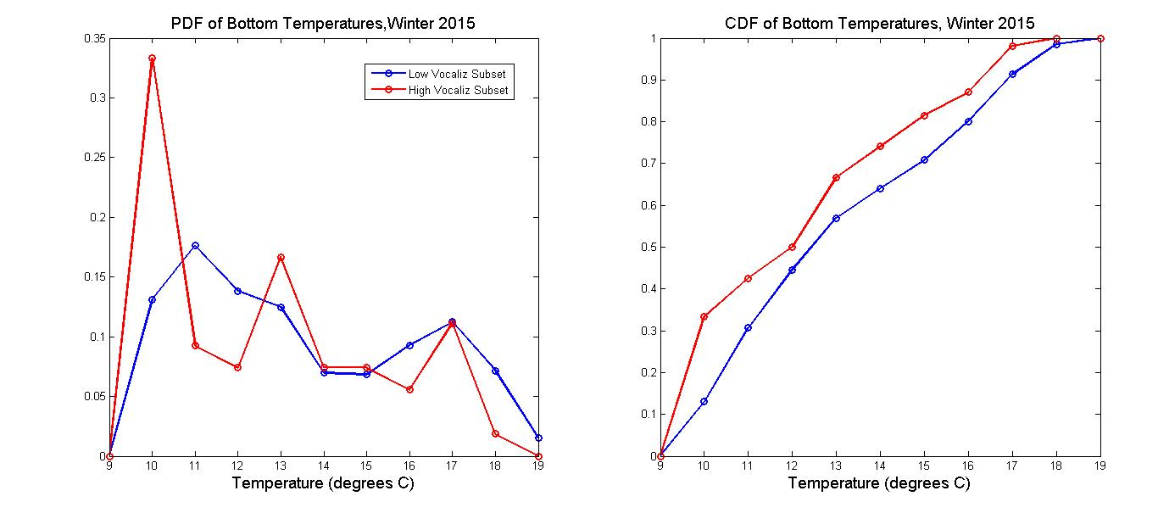
Correlating Detections to Oceanographic Features
PDF and CDF of bottom temperature for the winter of 2015. The “high vocalization” subset is in red. The “low vocalization” subset is in blue. The K-S test shows that these two CDFs are statistically different.
Notes:
The two sets ARE statistically different—at least for the Winter of 2015.

Slide 24
Correlating Detections to Oceanographic Features
Satellite image of sea surface temperature (SST) near Cape Hatteras on March 15, 2015, from Rutgers Coastal Ocean Observation Lab (COOL). I’ve added a star to show the location of our mooring, at a depth of 230m.
Notes:
Let’s go back to the image of the Gulf Stream to figure out what’s physically going on here.

Slide 25
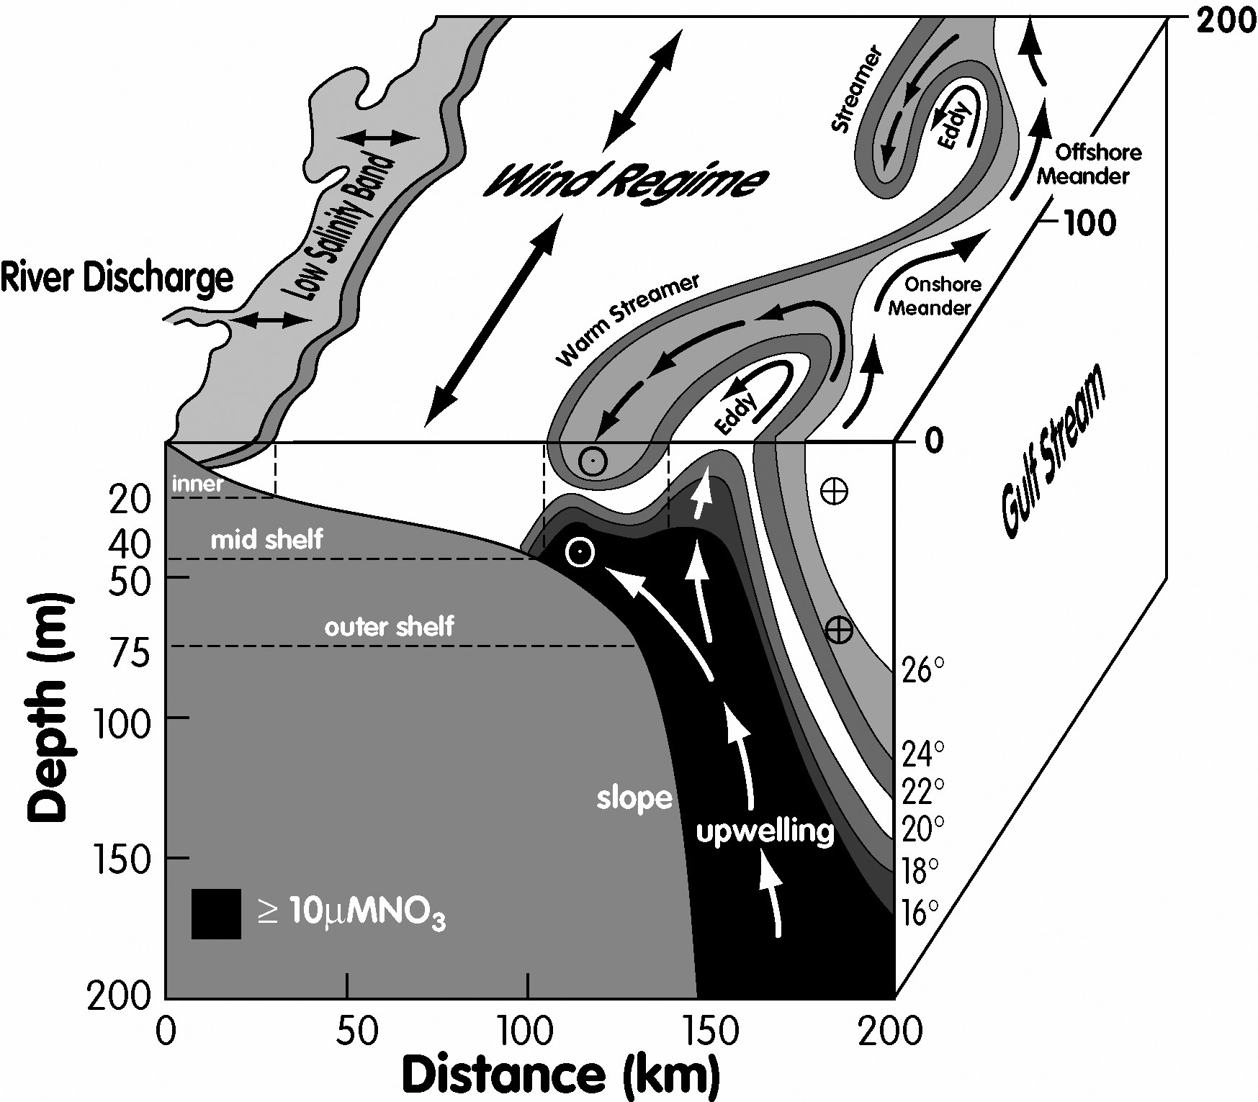
Correlating Detections to Oceanographic Features
From Jahnke and Blanton, 2010
Notes:
This graphic shows some of the complex processes going. Let’s look first at the surface, where we see Gulf Stream meanders—troughs and crest. At the crest, sometimes a filament (“warm streamer”) can peel off. Next, look at the cross-section to see the temperature structure of the stream as well as the upwelling of cool, nutrient-rich water which occurs when the Gulf Stream meanders offshore. Is this the cool water we are seeing when we have a lot of marine mammal vocalizations? Or, alternatively, are we sampling cool shelf water that slides down the slope (a process not shown on this slide)?

Slide 26
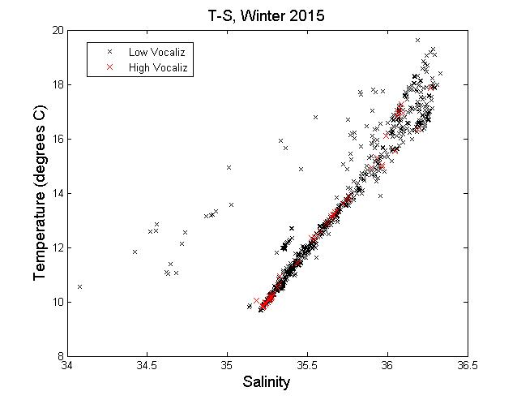
Correlating Detections to Oceanographic Features
T-S plot of bottom temperature for the winter of 2015. The “high vocalization” subset is in red. The “low vocalization” subset is in black.
Notes:
One way to answer this is to look at the T-S plot. Here’s the T-S plot for both sets of our data.

Slide 27
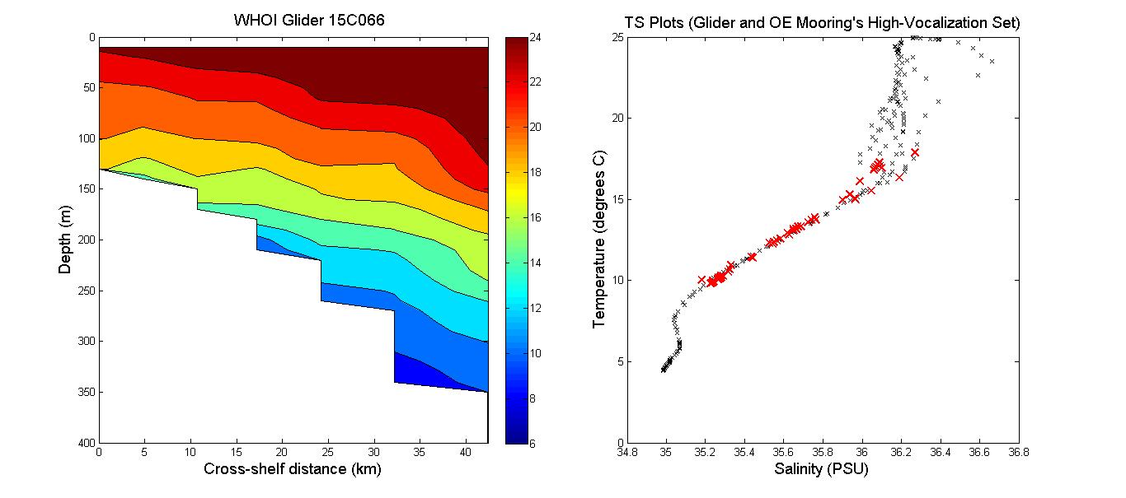
Correlating Detections to Oceanographic Features
The left panel shows a transect of temperature across the western half of the Gulf Stream during January of 2016, from WHOI Spray glider data, provided by Dr. Robert Todd. The right panel shows a T-S plot (in black) of the same glider transect as well as the T-S values from the mooring during high vocalization intervals (in red) in the winter of 2015.
Notes:
This plot shows that our T-S data does fall onto the characteristic T-S curve for the Gulf Stream. I acquired data from a glider transect of the western edge of the Gulf Stream near our mooring in January of 2016. The plot on the right shows that our “high-vocalization” set from the Winter of 2015 DOES fall nicely onto the characteristic T-S curve for the Gulf Stream. In other words, the cool water that we sampled when marine mammal vocalizations were high DOES belong to the Gulf Stream i.e. the cool, nutrient-rich water that upwells when the Gulf Stream meanders offshore. It’s not shelf water.

Slide 28
Correlating Detections to Oceanographic Features
So far, with data from the instruments on 1 mooring, I have shown that:
Marine mammal vocalizations increase when the Gulf Stream moves farther offshore
Notes:
We’re definitely hearing more whistling when the Gulf Stream is farther offshore, but is that “real”, or is it just an acoustic propagation effect? i.e. maybe the acoustic propagation to our mooring becomes more favorable when the Gulf Stream moves farther offshore.

Slide 29
Correlating Detections to Oceanographic Features
One can consider two possible explanations for the increase in vocalizations:
We are truly measuring an increase in marine mammal abundance the Gulf Stream moves farther offshore.
Alternatively, the observed correlation could be merely an acoustic propagation effect.
Notes:
We’re definitely hearing more whistling when the Gulf Stream is farther offshore, but is that “real”, or is it just an acoustic propagation effect? i.e. maybe the acoustic propagation to our mooring becomes more favorable when the Gulf Stream moves farther offshore. So, I modeled the acoustic propagation, presented it in a poster at the ASA 2016 meeting, and I got useful feedback from the experts…

Slide 30
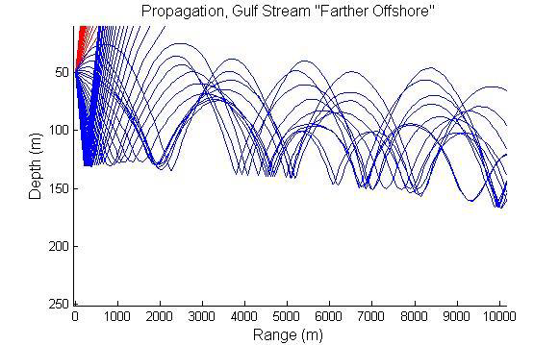
Correlating Detections to Oceanographic Features
I did some modeling of the acoustic propagation, using glider transect data….

Slide 31
Correlating Detections to Oceanographic Features
Our detection range (at SNR of 10dB) is only 1-2 km. Therefore, it is likely that we are truly measuring increased marine mammal abundance.
Notes:
Their feedback was that with my detection SNR threshold high (at 10dB) I’m recording only the marine mammals that are close to the hydrophone.

Slide 32
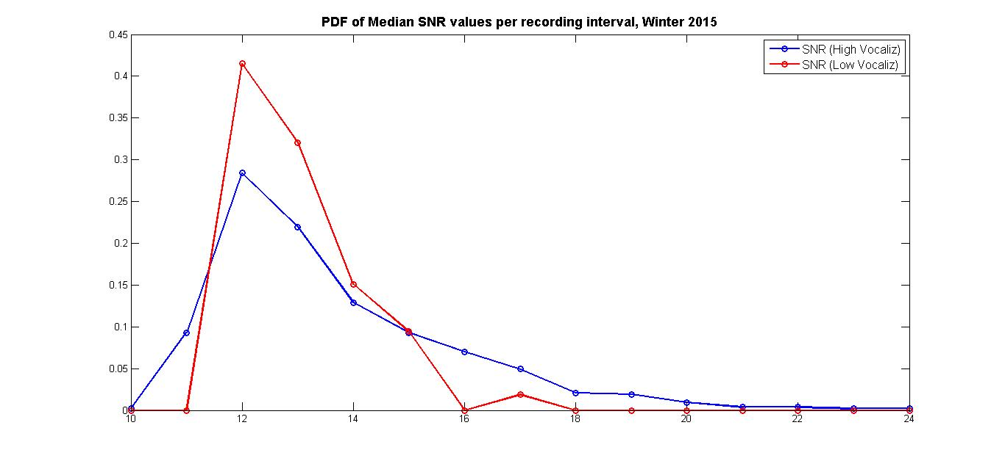
Correlating Detections to Oceanographic Features
PDF of the median SNR of the recorded whistles, per recording interval. The data has been divided into two subsets, one for SNR when the vocalization metric was above a threshold (15 seconds) per recording interval, another for the SNR when the vocalization metric was below the threshold.
Notes:
For this SNR threshold, we see that the distribution of SNR of the detected whistles is the same for both sets. So, it’s NOT like we’re hearing a lot of distant, faint whistles when the Gulf Stream moves farther offshore. We’re always hearing what’s close by. When the Gulf Stream moves farther offshore, there is more marine mammals vocalizing nearby.

Slide 33
Conclusions
Detected marine mammal vocalizations (whistles and click trains) in a large (~1TB) set of wav files
Using a combination of my own custom matlab code and off-the-shelf tools
Classification of click trains is in progress
Using just 1 mooring, I was able to correlate marine mammal vocalizations to oceanographic features
Using a statistical approach (K-S test of the CDFs)
Using insight into the physical processes
Next steps include:
Low-frequency analysis
Finish characterizing the noise
More hydrophone data (OE + PEACH)

Slide 34
References
Branstetter, BK, E Mercado and WWL Au (2007). Representing multiple discrimination cues in a computational model of the bottlenose dolphin auditory system. J. Acoust. Soc. Am. 122,2459–2468.​
Hildebrand JA (2009) Anthropogenic and natural sources of ambient noise in the ocean. Mar Ecol Prog Ser 395:5-20. https://doi-org.libproxy.lib.unc.edu/10.3354/meps08353
Jahnke, RA and JO Blanton. The Gulf Stream. Chaper 3 in Carbon and Nutrient Fluxes in Continental Margins, Springer, 2010.
Kandia V and Y Stylianou. Detection of sperm whale clicks based on the Teager–Kaiser energy operator. Applied Acoustics, 2006, 67:1144–1163.
Roch MA, TS Brandes, B Patel, Y Barkley, S Baumann-Pickering, MS Soldevilla (2011) Automated extraction of odontocete whistle contours. J. Acous. Soc. Am., 130(4), 2212-2223.
Zaugg S, M van der Schaar, L Houégnigan, C Gervaise, M André. Real-time acoustic classification of sperm whale clicks and shipping impulses from deep-sea observatories. Applied Acoustics, 2010, 71(11):1011-1019. http://dx.doi.org/10.1016/j.apacoust.2010.05.005.

